Slide 1
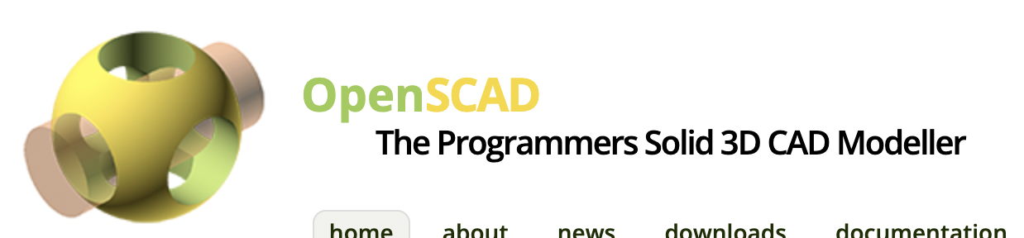
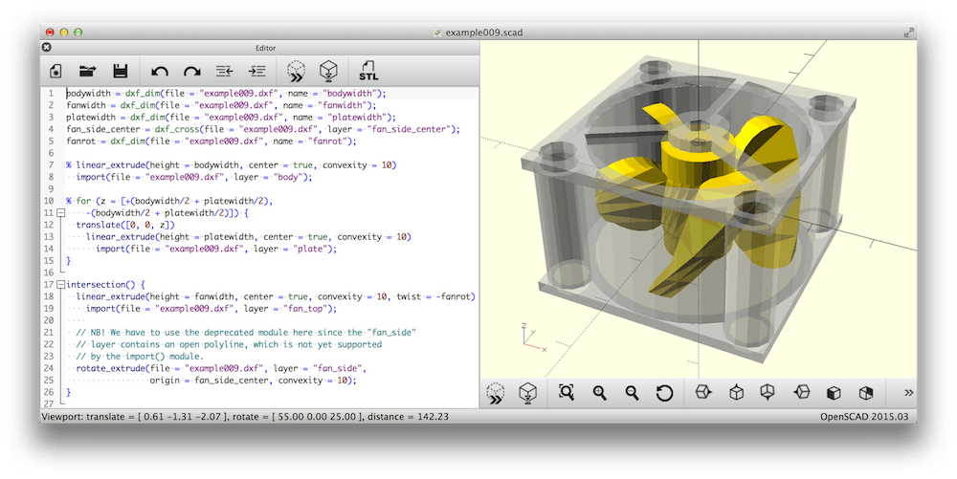

Slide 2
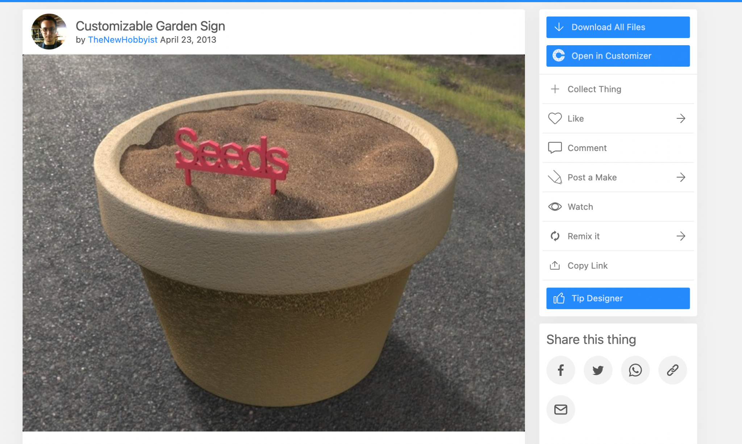

Slide 3
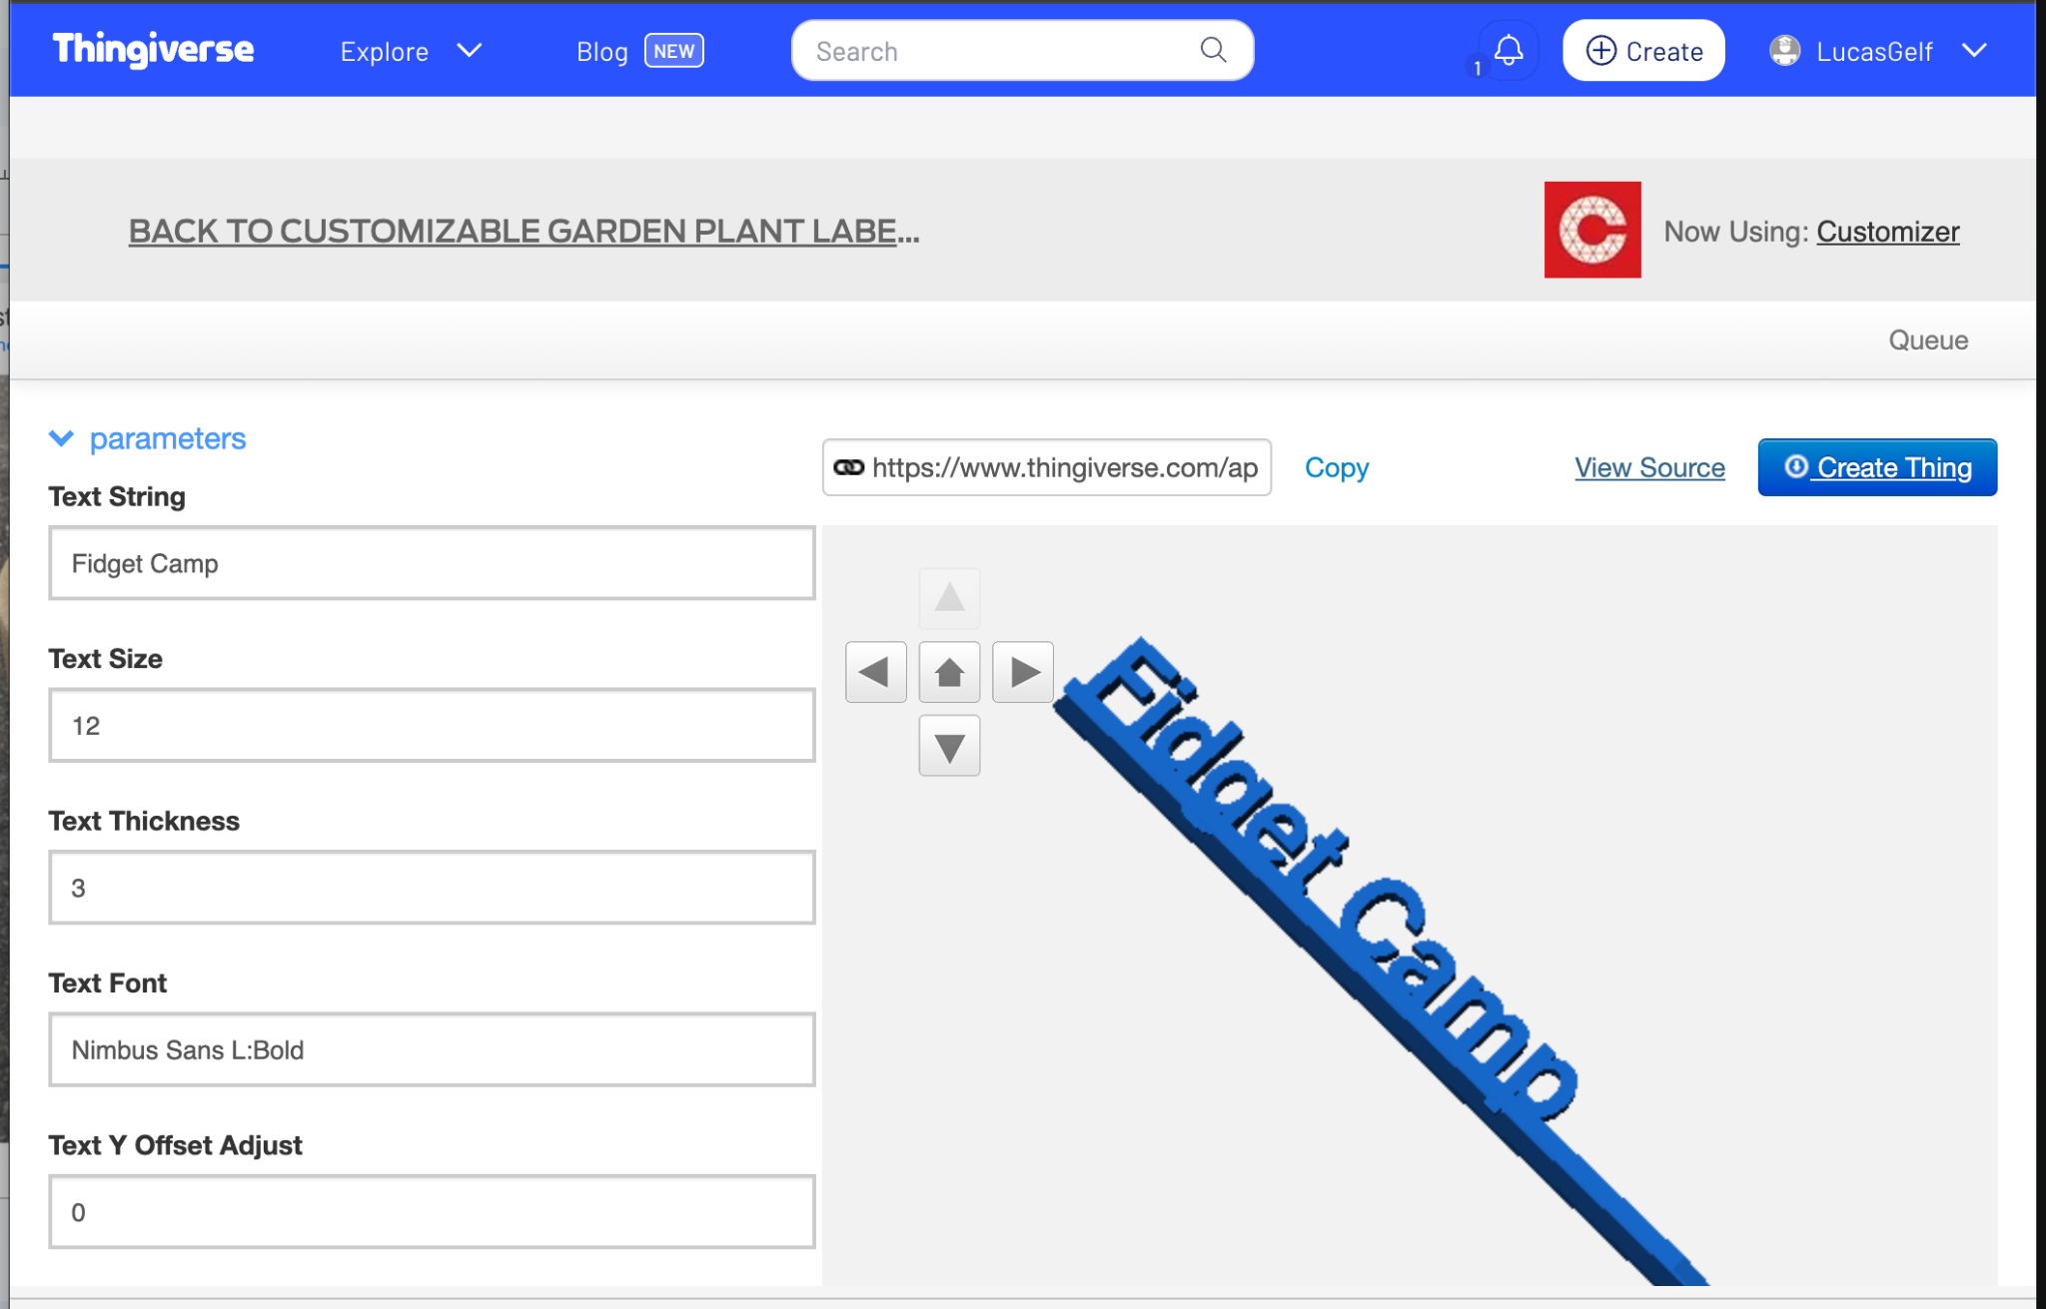

Slide 4
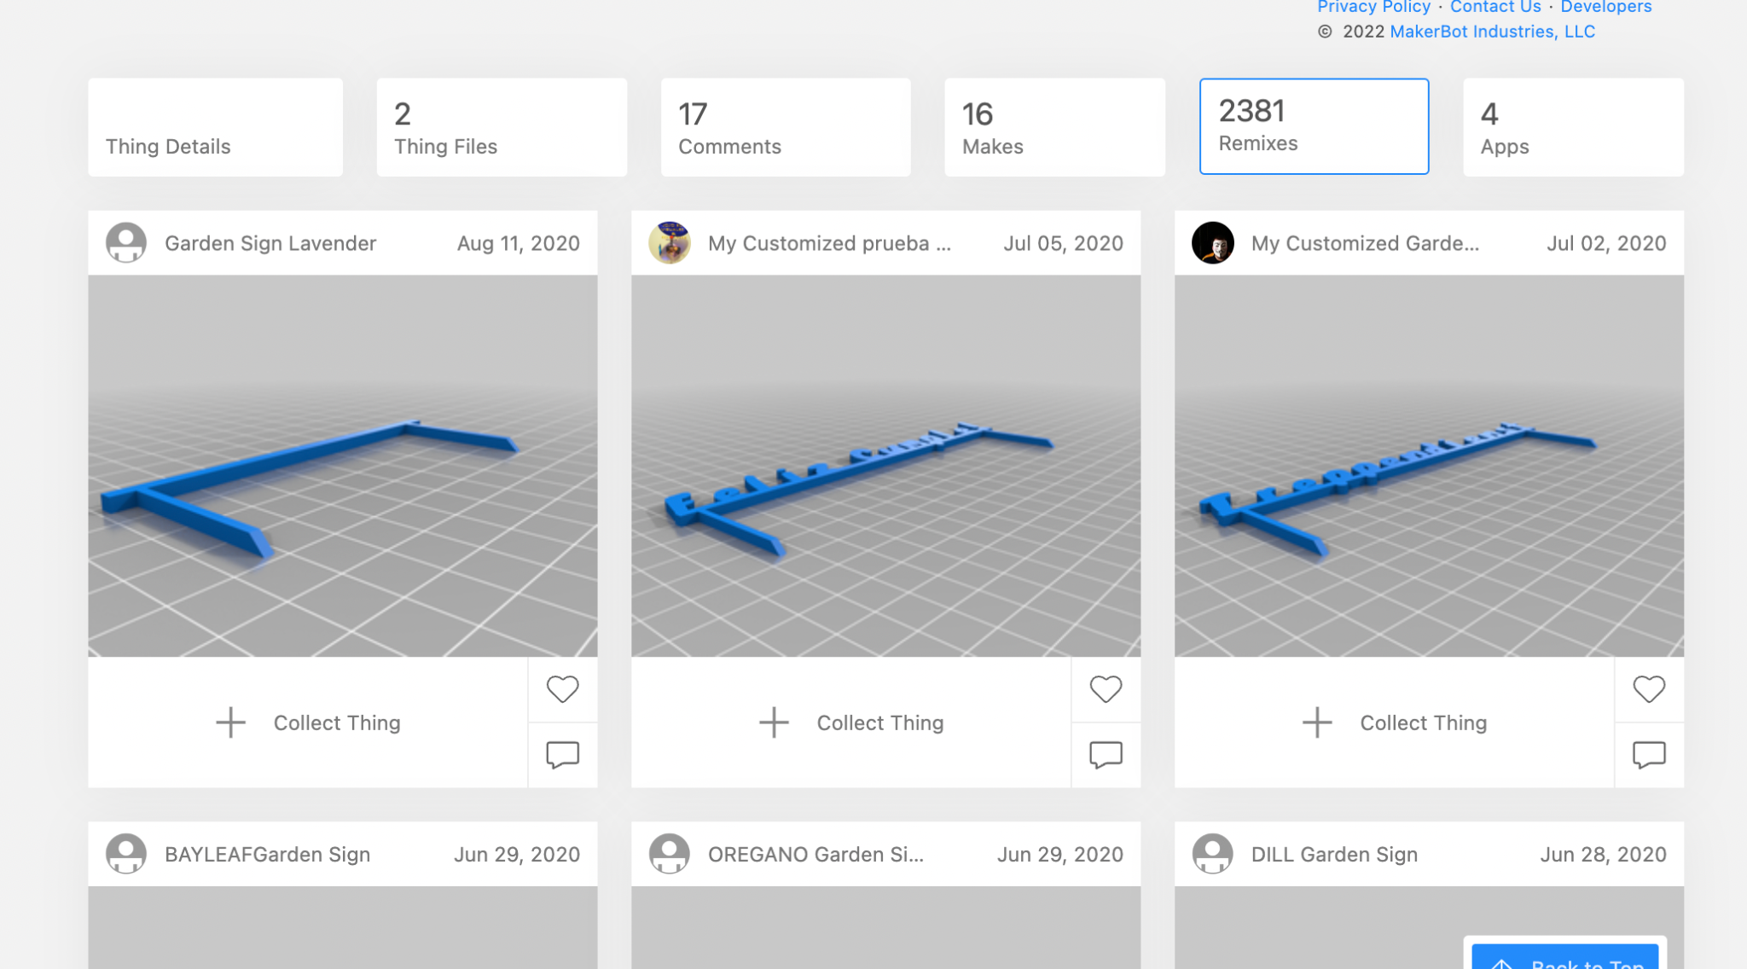

Slide 5
Totally parametric!!!

Slide 6
what can you make

Slide 7
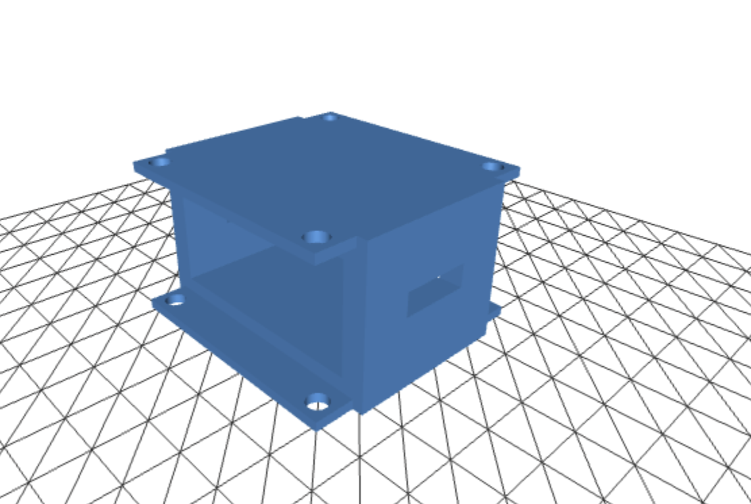
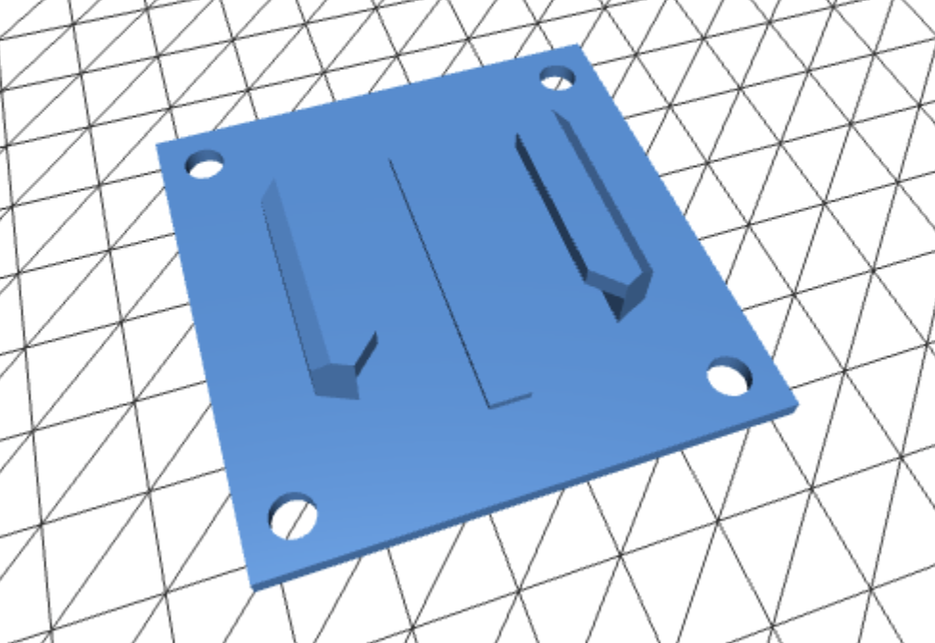
drone gopro mount and battery housing

Slide 8
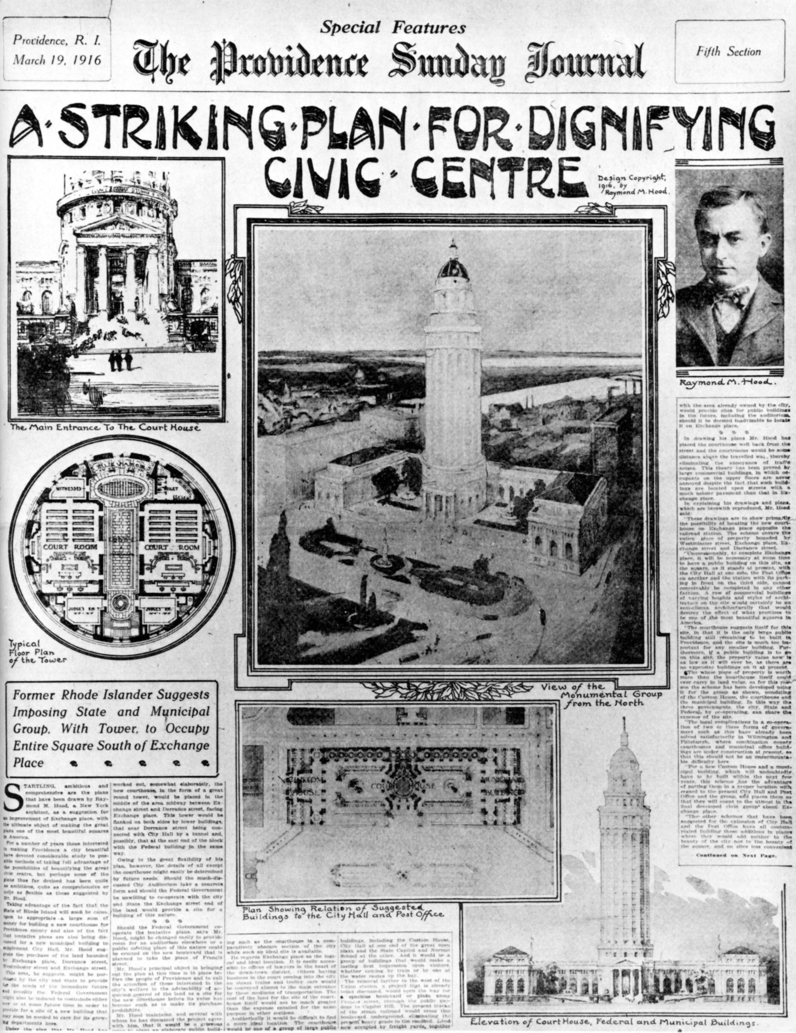
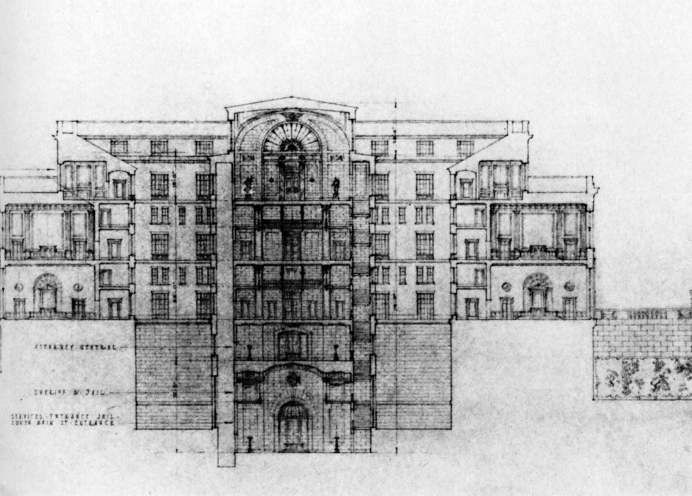
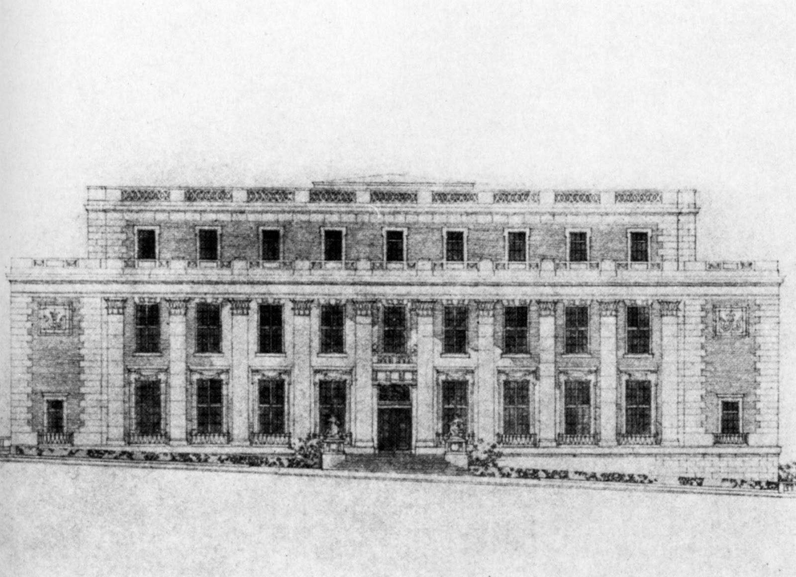
architectural models

Slide 9
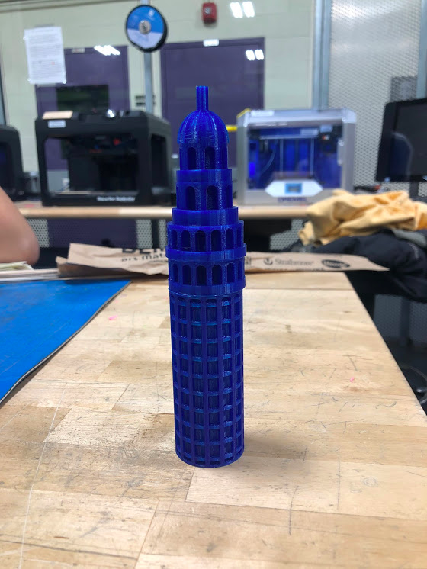
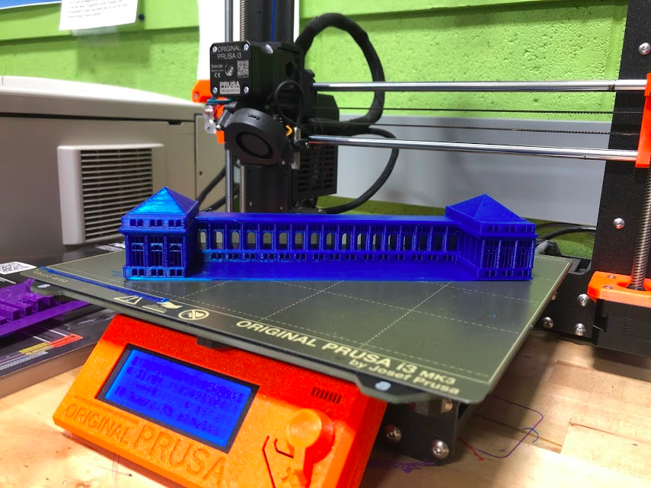
architectural models

Slide 10
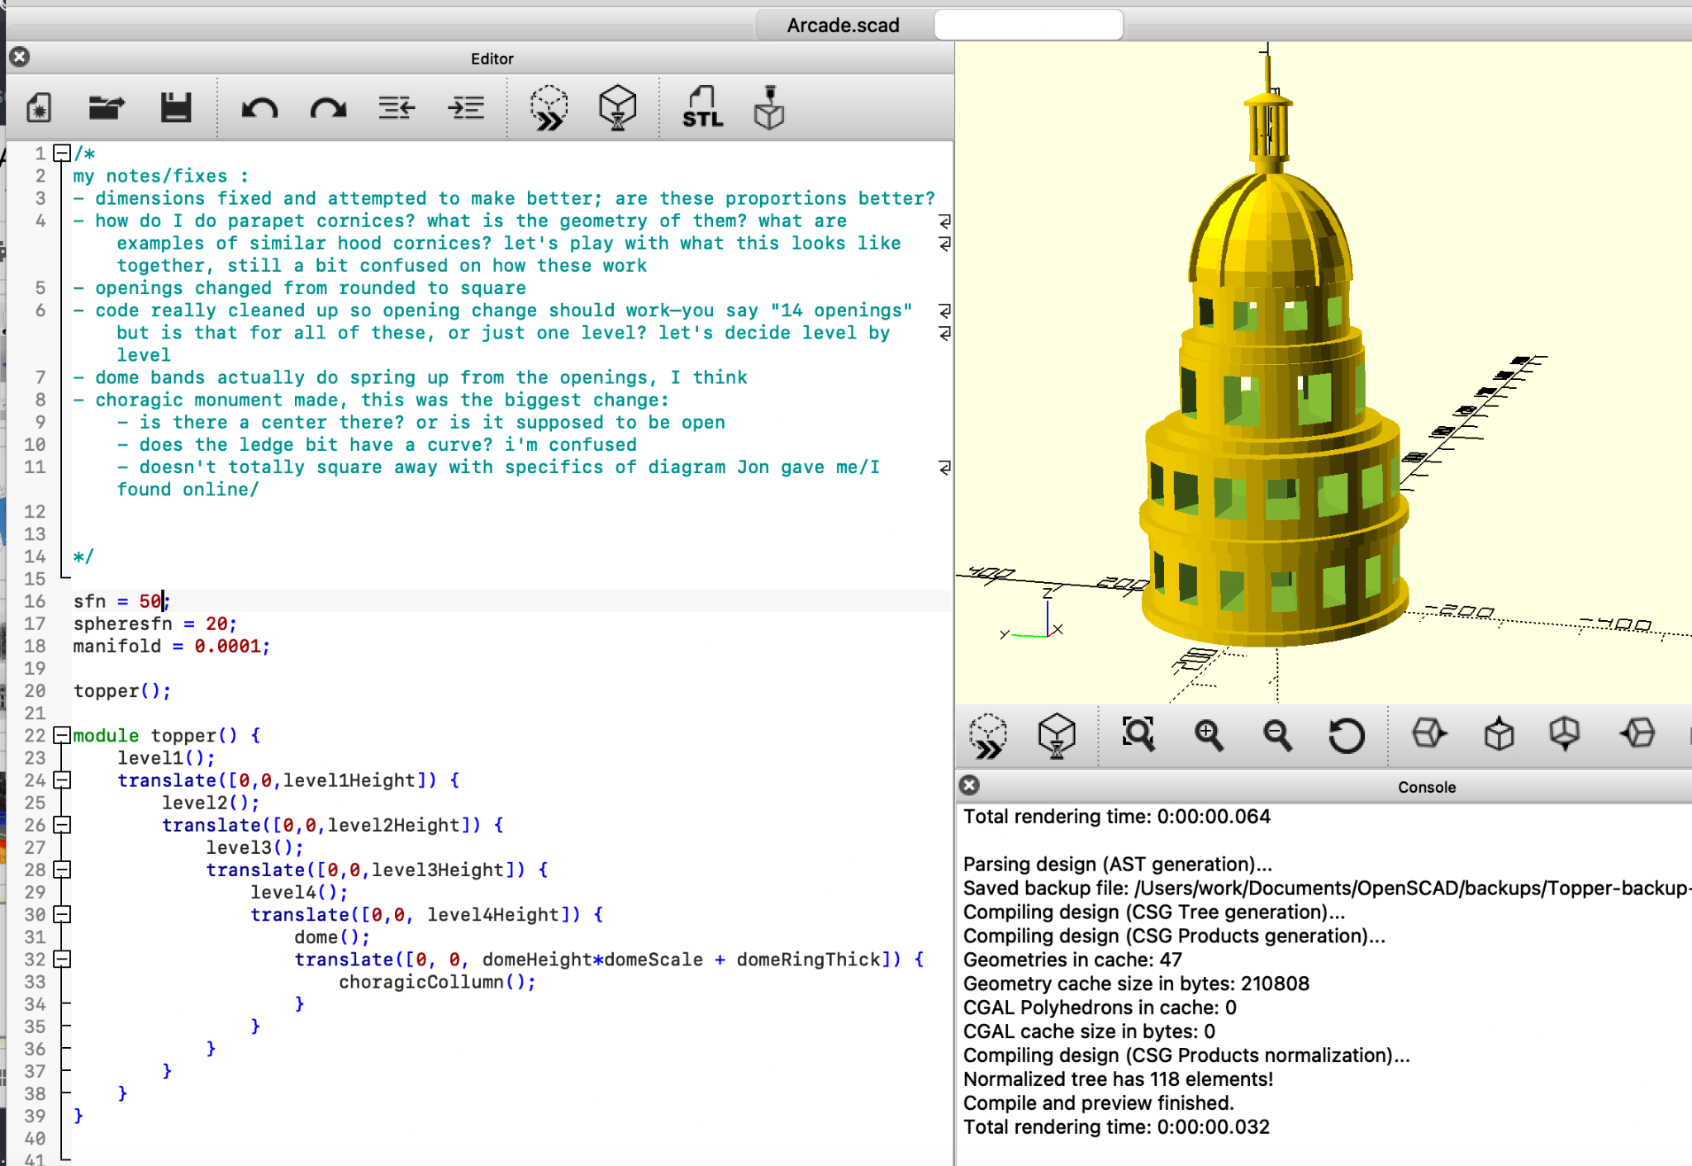
architectural models
https://github.com/lucasgelfond/Providence-City-Center-Model

Slide 11
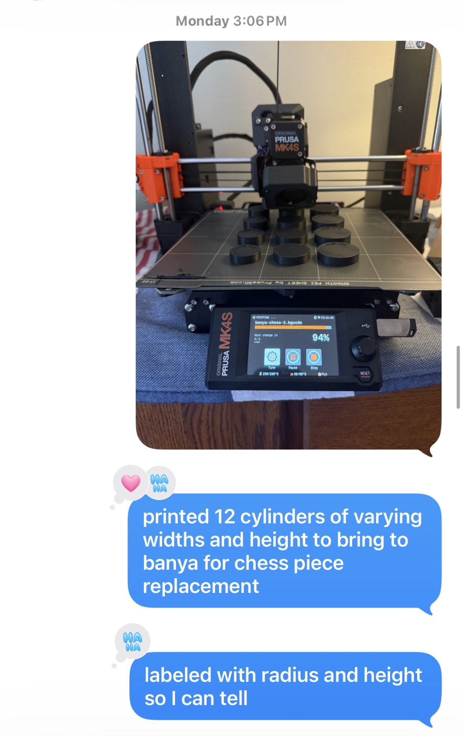
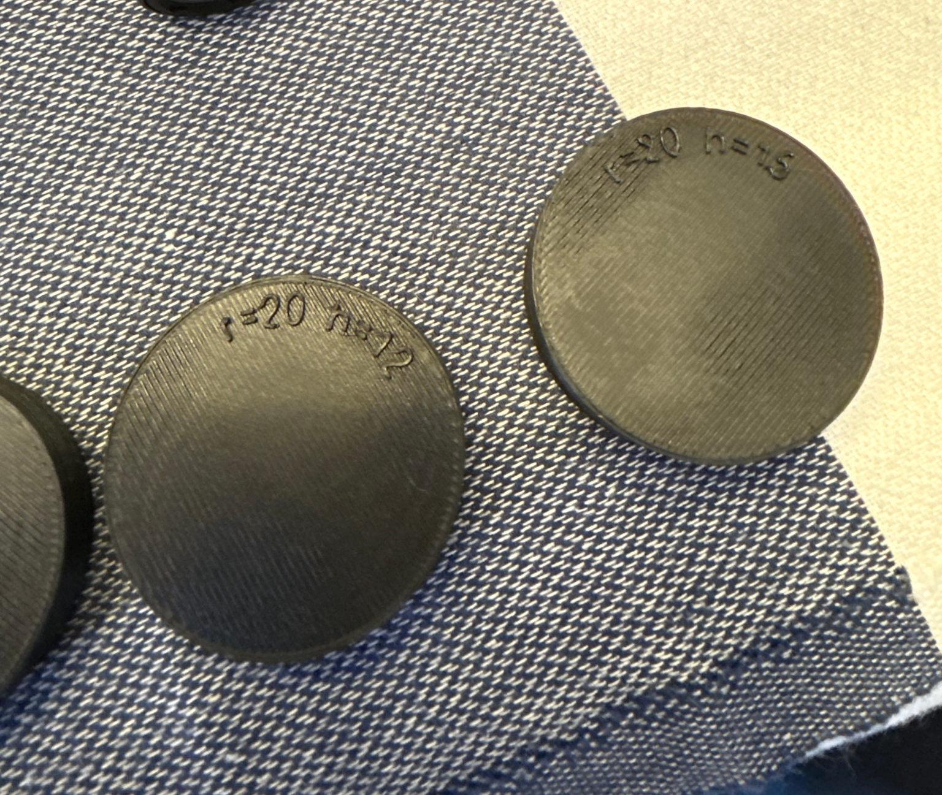
replacement banya chess pieces

Slide 12
Interactive part!
download OpenSCAD (~27 MB)
http://openscad.org/downloads.html
OR
brew install openscad
the official docs (linked on their site) are incredible

Slide 13
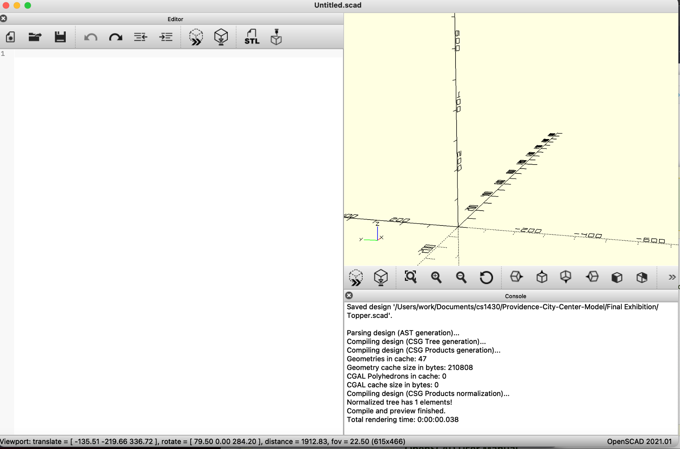
Viewport
(two finger click to navigate)
Editor
Logs

Slide 14
information dump / crash course
(and reminder to self to not speed through this)

Slide 15
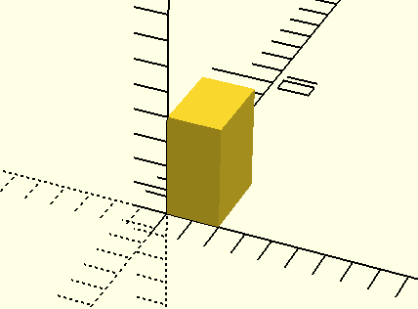

cube([2, 3, 4]);
F5 to render
click to Reset View if you can’t see

Slide 16
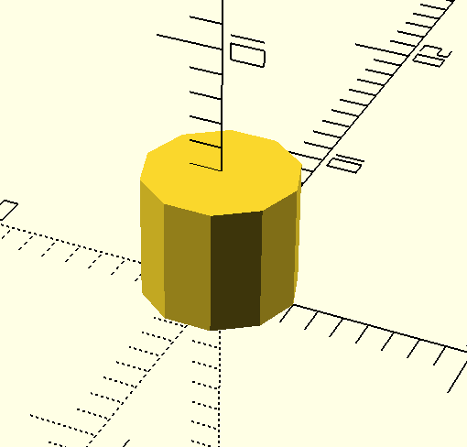
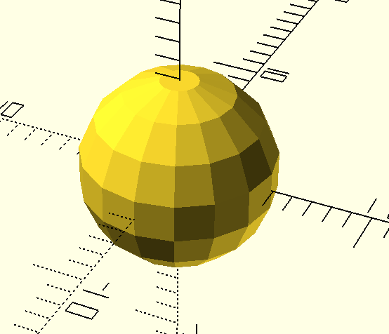
cylinder(r = 3, h = 5);
sphere(r = 5)
object primitives:
cube([width, depth, height]);
cylinder(r = radius, h = height)
sphere(r = radius)

Slide 17
transforms
translate([x, y, z]) { }
rotate([x, y, z]) { } (degrees)
scale ([x, y, z]) { } (default: [1, 1, 1])

Slide 18
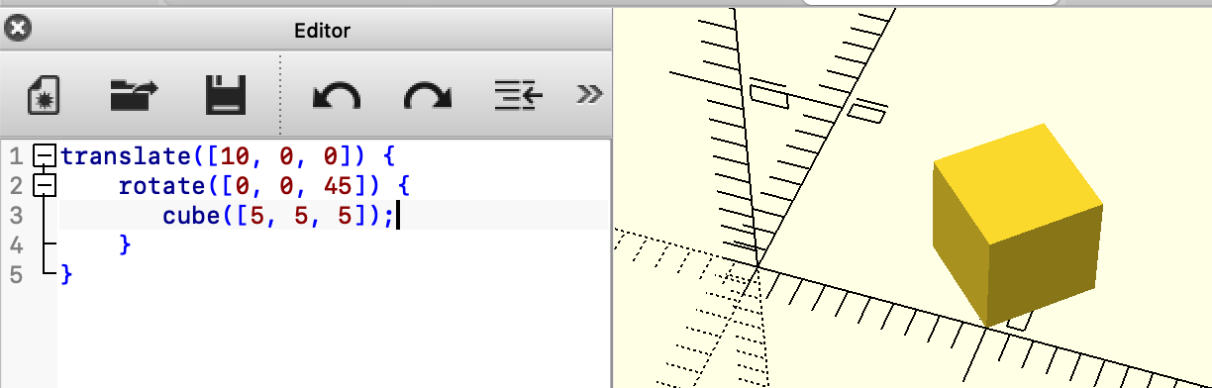
transforms can be nested!
This would
create a 5x5x5 cube
rotate it 45 degrees about the Z axis
translate it 10 units across the X axis
NOTE: would get a different result if we did in a different order!

Slide 19
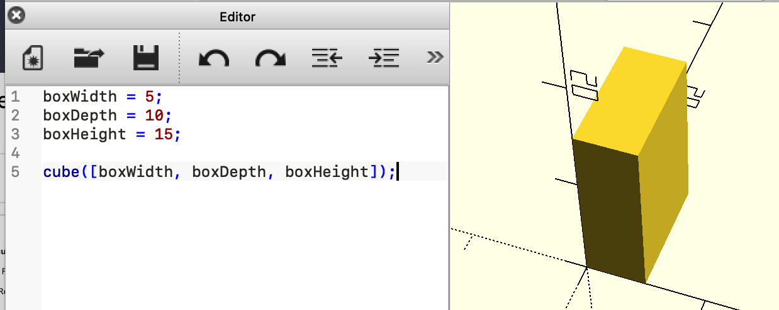
variables never change and need no declaration

Slide 20
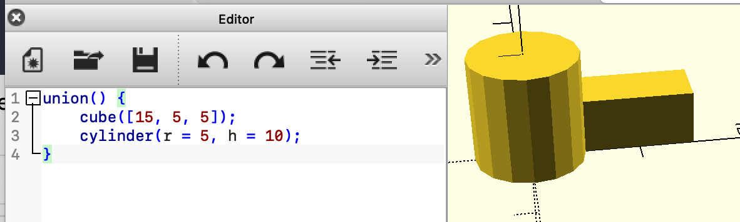
union()

Slide 21
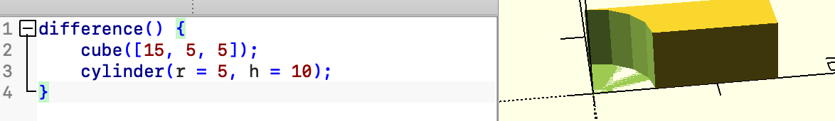
difference()

Slide 22
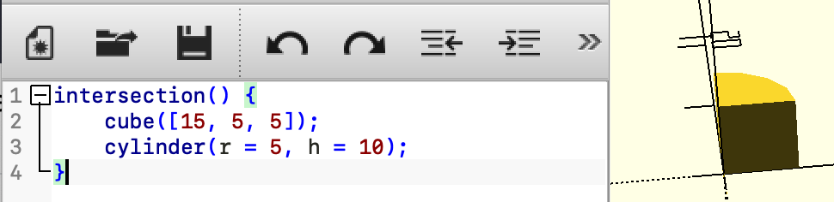
intersection()

Slide 23
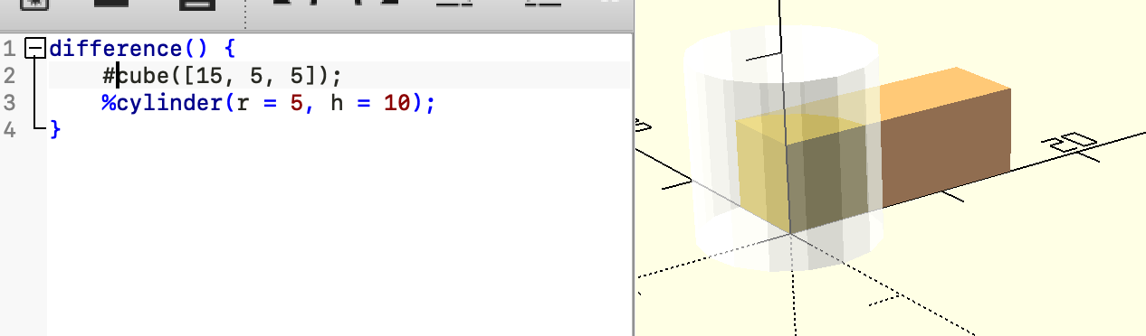
“debugging” with % and #

Slide 24
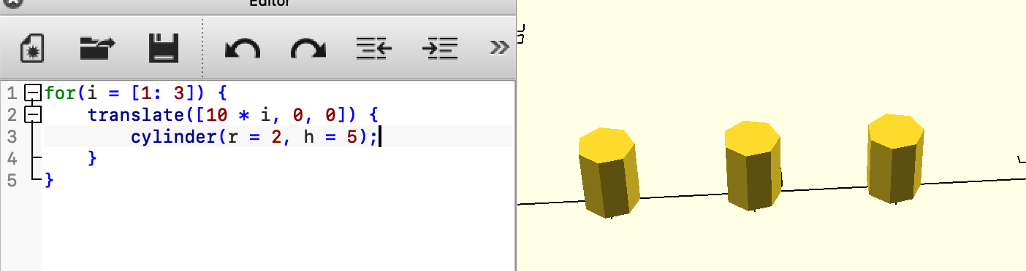
for() and repetition

Slide 25
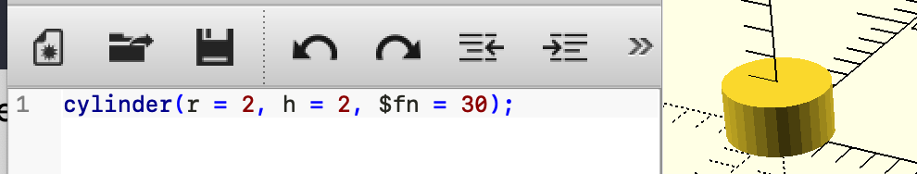
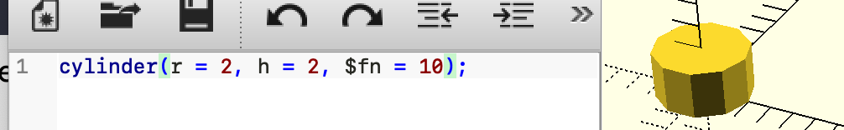
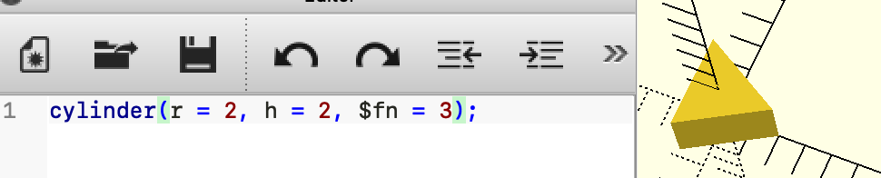
miscellany: $fn

Slide 26
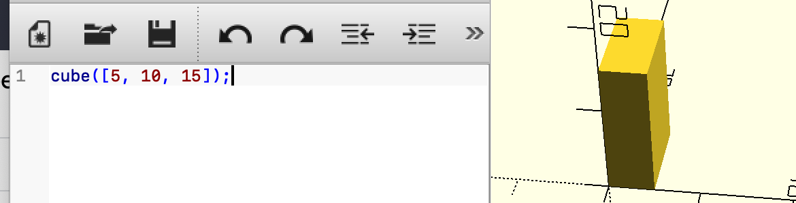
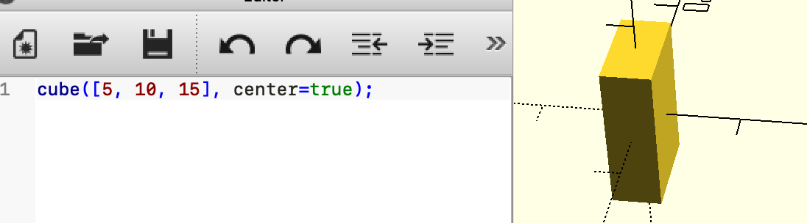
miscellany: center=true

Slide 27
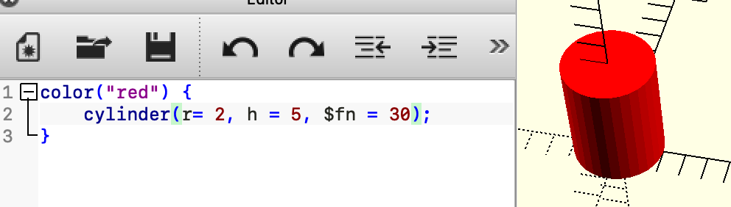
miscellany: color(“colorname”)

Slide 28
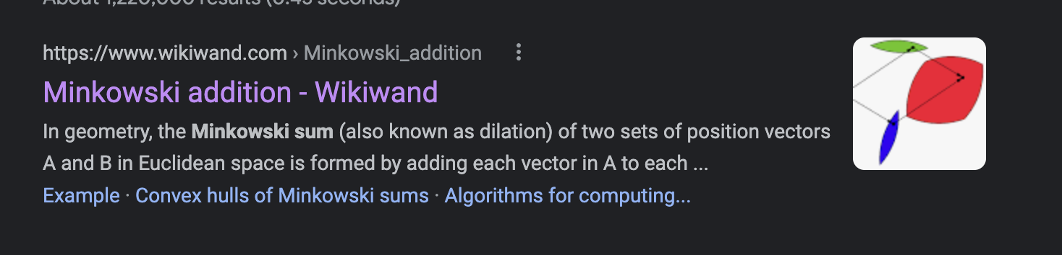
fun bonus: minkowski()

Slide 29
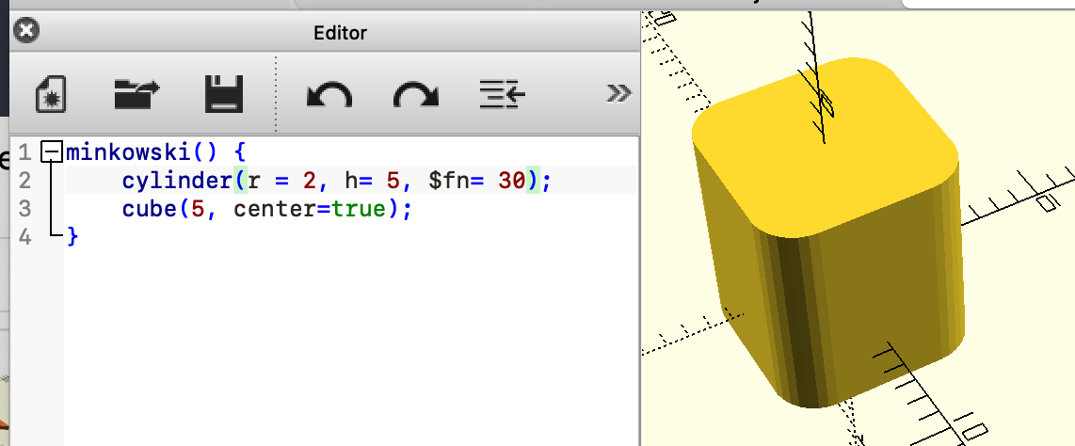
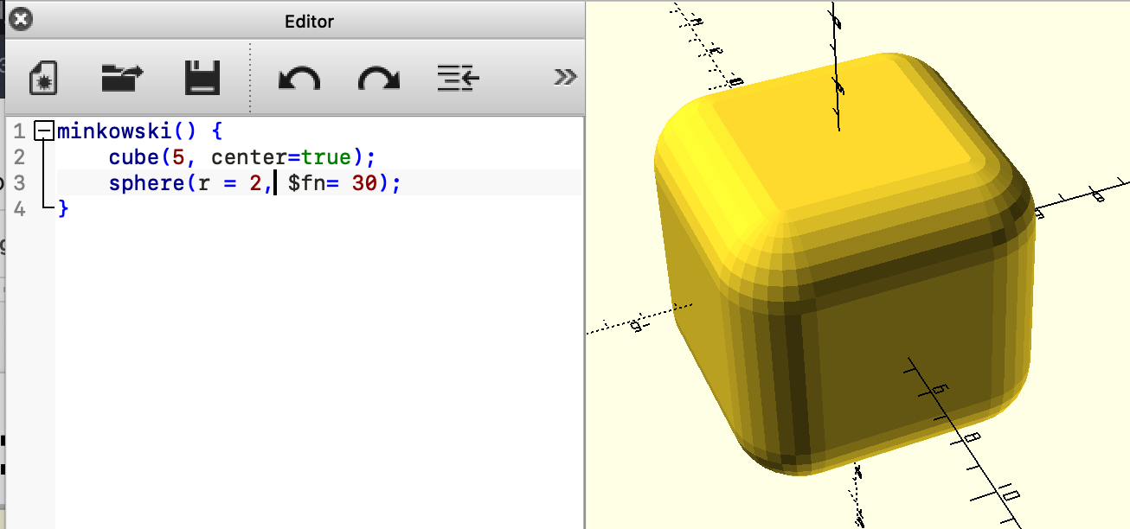
fun bonus: minkowski()

Slide 30
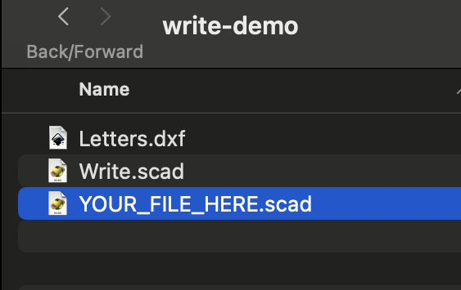
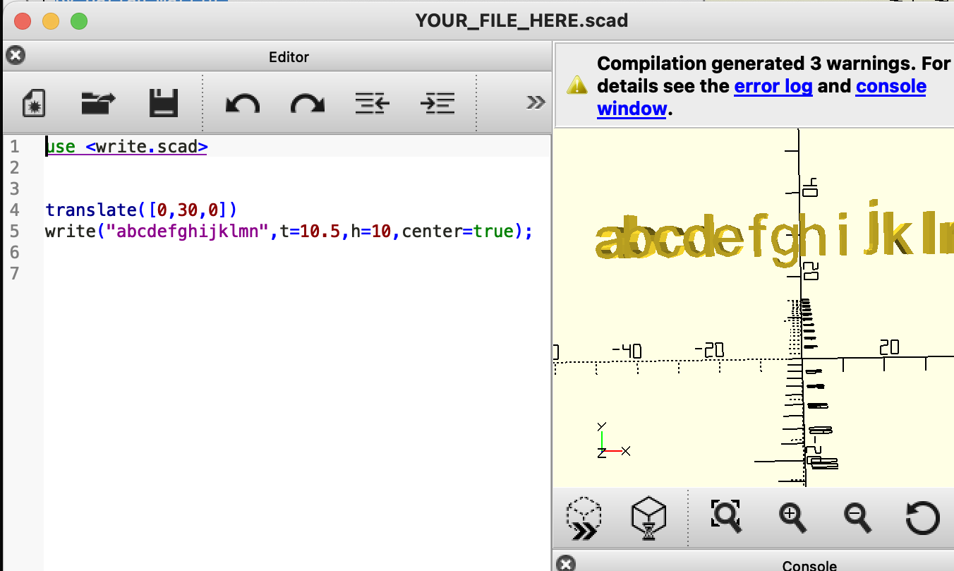
fun bonus: Write.scad
this setup is annoying; there’s a ZIP in Slack!

Slide 31
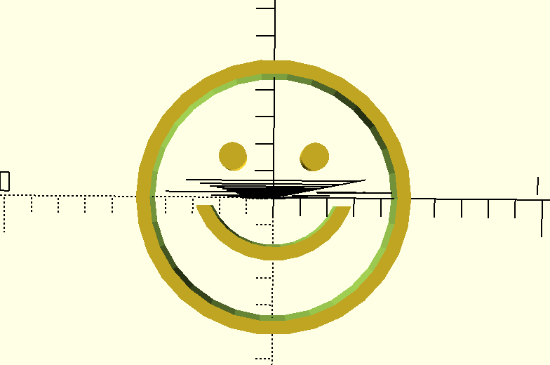
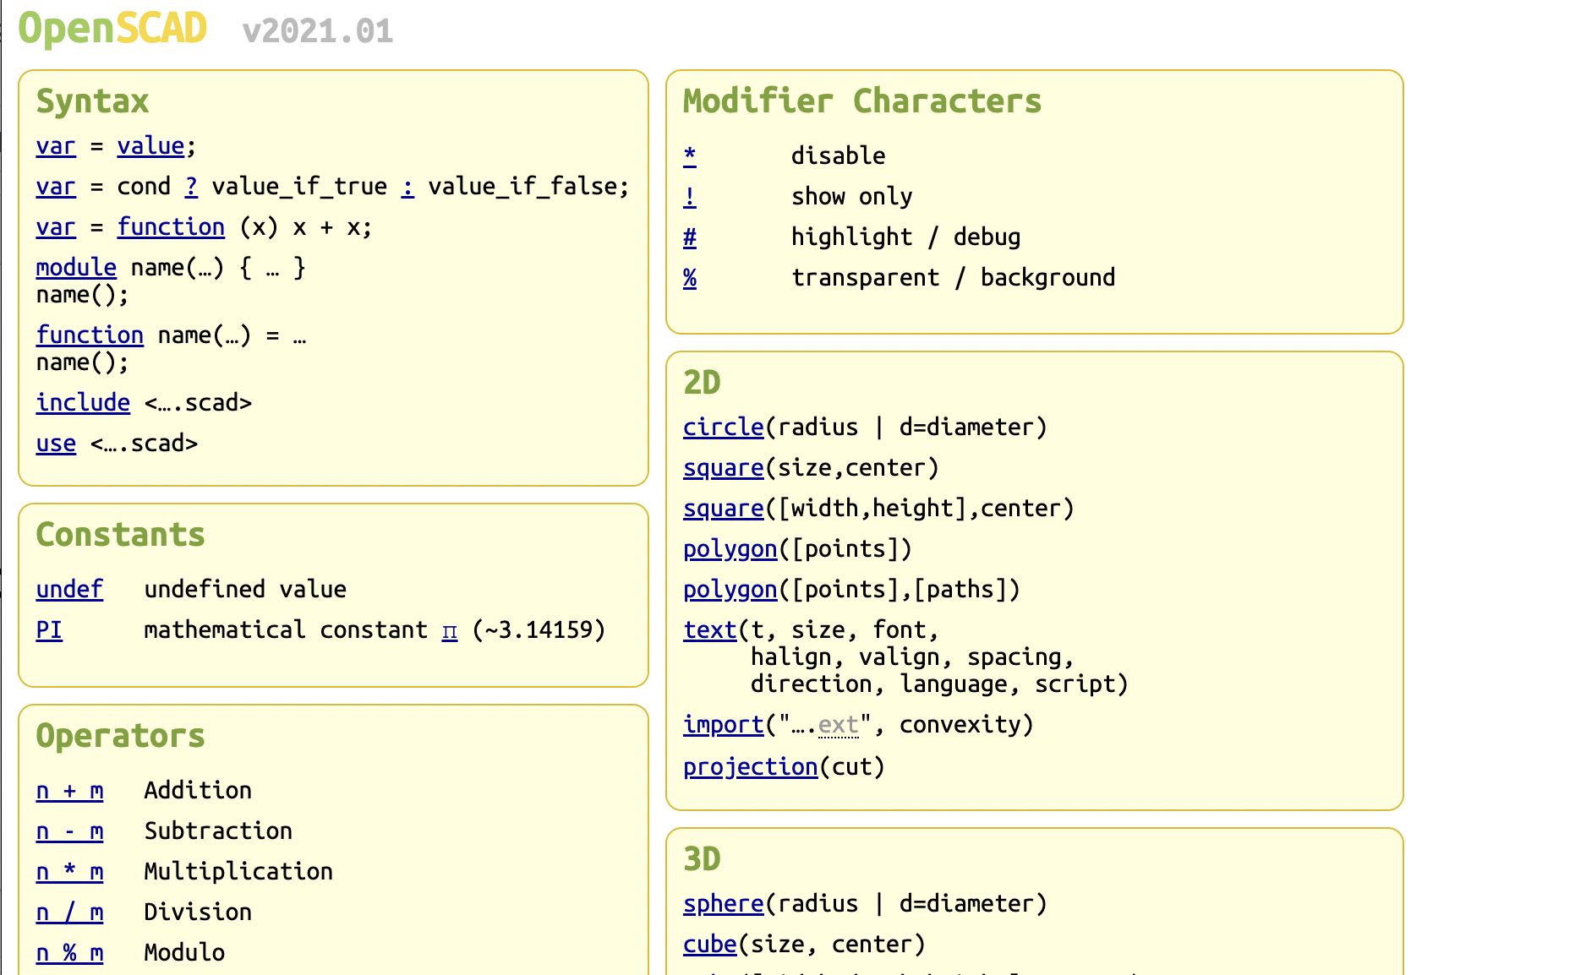
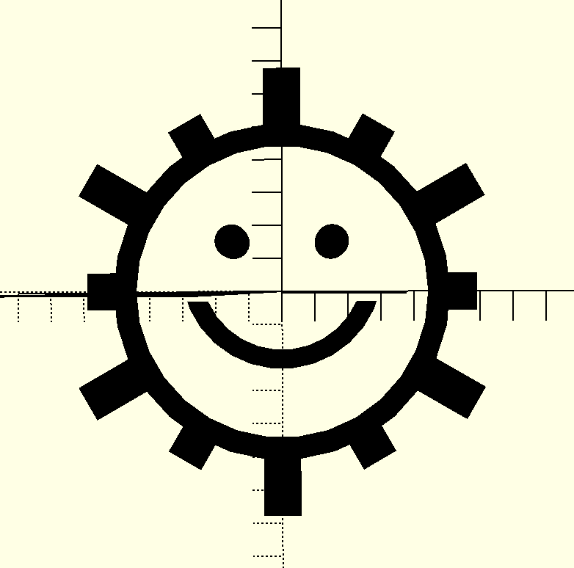

Your Challenge(s)
https://openscad.org/cheatsheet/
v1
v2
v3

Slide 32
(spoiler ahead!)

Slide 33
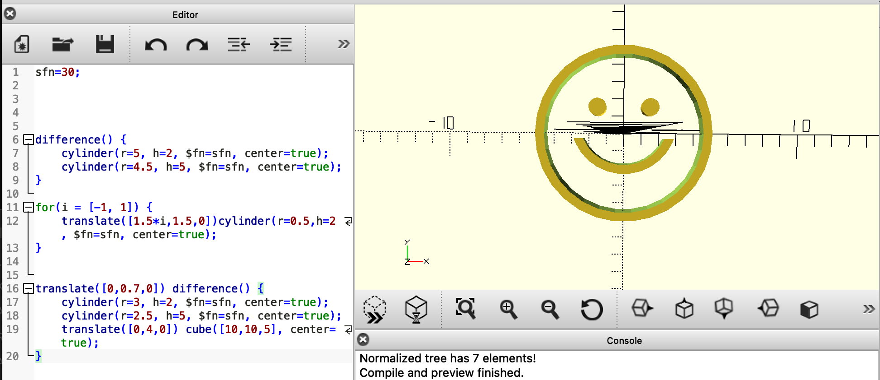
smiley-1.scad

Slide 34
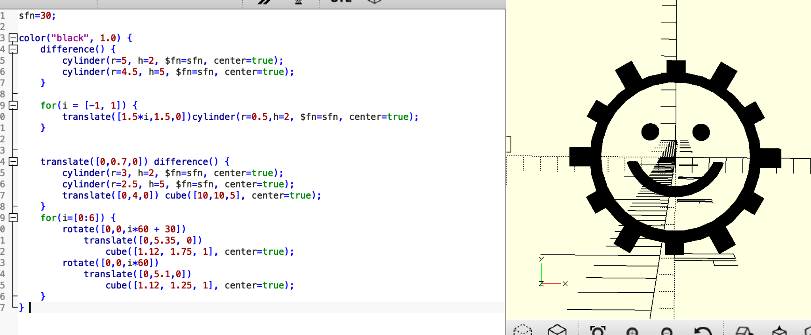
smiley-2.scad

Slide 35
slides from when i did this as a lunch ’n learn

Slide 36
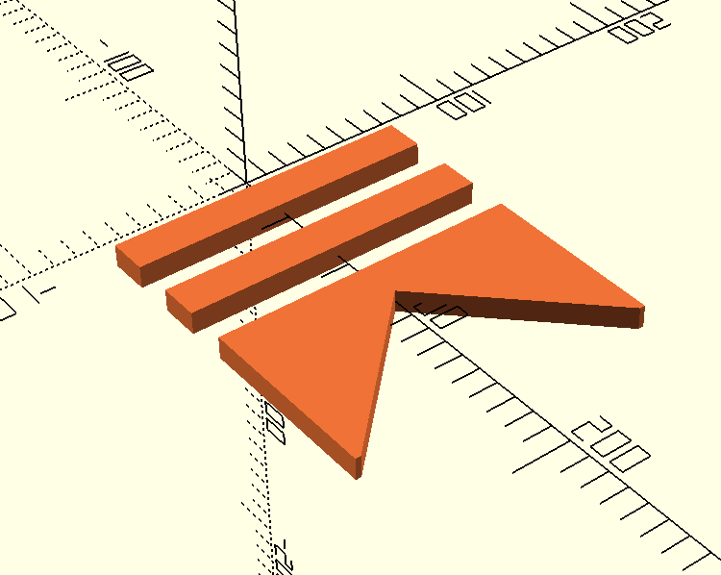
Your Challenge
https://openscad.org/cheatsheet/

Slide 37
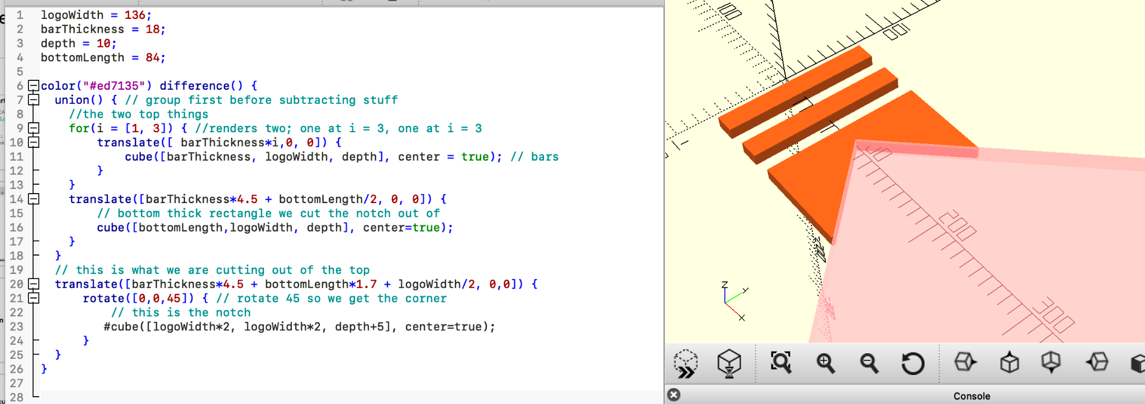
Notes:
logoWidth = 136;
barThickness = 18;
depth = 10;
bottomLength = 84;
color("#ed7135") difference() {
union() { // group first before subtracting stuff
//the two top things
for(i = [1, 3]) { //renders two; one at i = 3, one at i = 3
translate([ barThickness*i,0, 0]) {
cube([barThickness, logoWidth, depth], center = true); // bars
}
}
translate([barThickness*4.5 + bottomLength/2, 0, 0]) {
// bottom thick rectangle we cut the notch out of
cube([bottomLength,logoWidth, depth], center=true);
}
}
// this is what we are cutting out of the top
translate([barThickness*4.5 + bottomLength*1.7 + logoWidth/2, 0,0]) {
rotate([0,0,45]) { // rotate 45 so we get the corner
// this is the notch
#cube([logoWidth*2, logoWidth*2, depth+5], center=true);
}
}
}

Slide 38
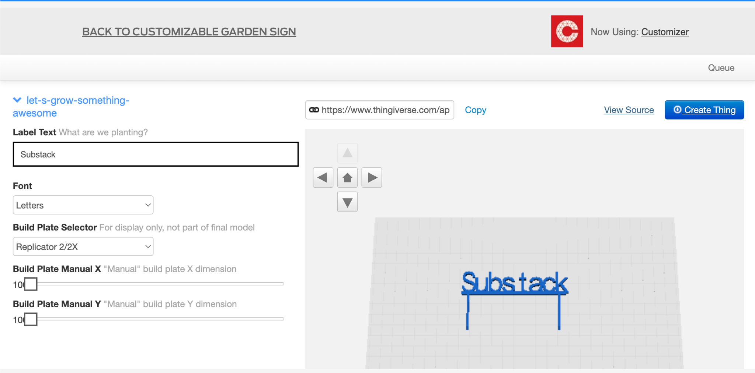

Slide 39
